Slide 1
Designing a complex intervention development study: experiences from a postdoctoral fellowship application
Dr Gregory A. Whitley PhD MCPara
19-Apr-2023

Slide 2
Disclaimer
This project was funded by the NIHR [Applied Research Collaboration – East Midlands] and Health Education England. The views expressed are those of the author(s) and not necessarily those of the NIHR or the Department of Health and Social Care.

Slide 3
Plan
The problems [pre-application]
The solution [application development]
Development process
Time
Funding
Team
PPIE
Costings
Key literature
The product [application]
Take away messages

Slide 4
The problems
PhD Thesis: prehospital pain management in children
Problem #1
Transition from:
PhD thesis to,
Postdoc
“What is the next step?”

Slide 5
The problems
Problem #2: Requirement for impact:
Clinical research with a shorter pathway to impact = more likely to receive funding.
Exploratory
Interventional

Slide 6
The problems
Problem #3: Need for career advancement
Need for:
Training & mentorship
Experience
Funding & publications
Impact

Slide 7
The solution…
A postdoctoral fellowship
Salary Costs
Research Costs
Training Costs

Slide 8
The solution
HEE/NIHR ICA ACAF
2-5 years full-time
20-40% professional practice development
PhD
Registered with eligible body
NIHR ICA Website

Slide 9
The solution
Decision
Design a study to develop and test a complex intervention to improve pain management for children and young people attended by ambulance
HEE/NIHR ICA ACAF
Propose a substantial research project
Programme of training and development
What are complex interventions?
An intervention might be considered complex because of properties of the intervention itself, such as the
number of components involved;
the range of behaviors targeted;
expertise and skills required by those delivering and receiving the intervention;
the number of groups, settings, or levels targeted;
or the permitted level of flexibility of the intervention or its components.
Skivington et al 2021

Slide 10
The solution
Date: 15-Jun-2021
Development process

Slide 11
The solution
Date: 25-Jun-2021
Development process
Changes:
Review dropped
Feasibility testing added

Slide 12
The solution
Date: 12-Jul-2021
Development process
Changes:
Previous evidence added
Consensus methods expanded

Slide 13
The solution
Date: 06-Sep-2021
Development process
Changes:
Removed NPT as theoretical framework

Slide 14
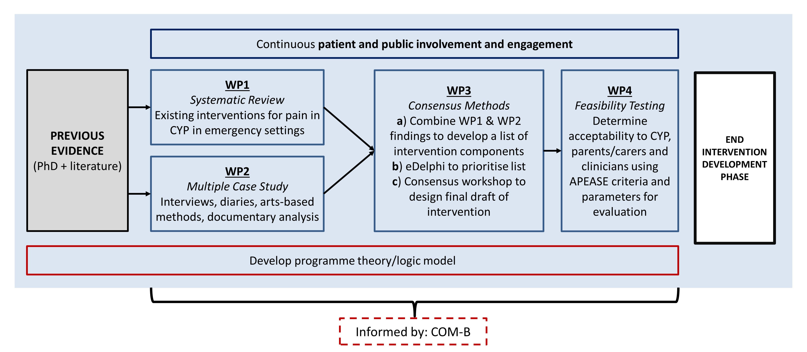
The solution
Date: 22-Nov-2021
Development process
Changes:
Added review back in
Restructure consensus methods

Slide 15
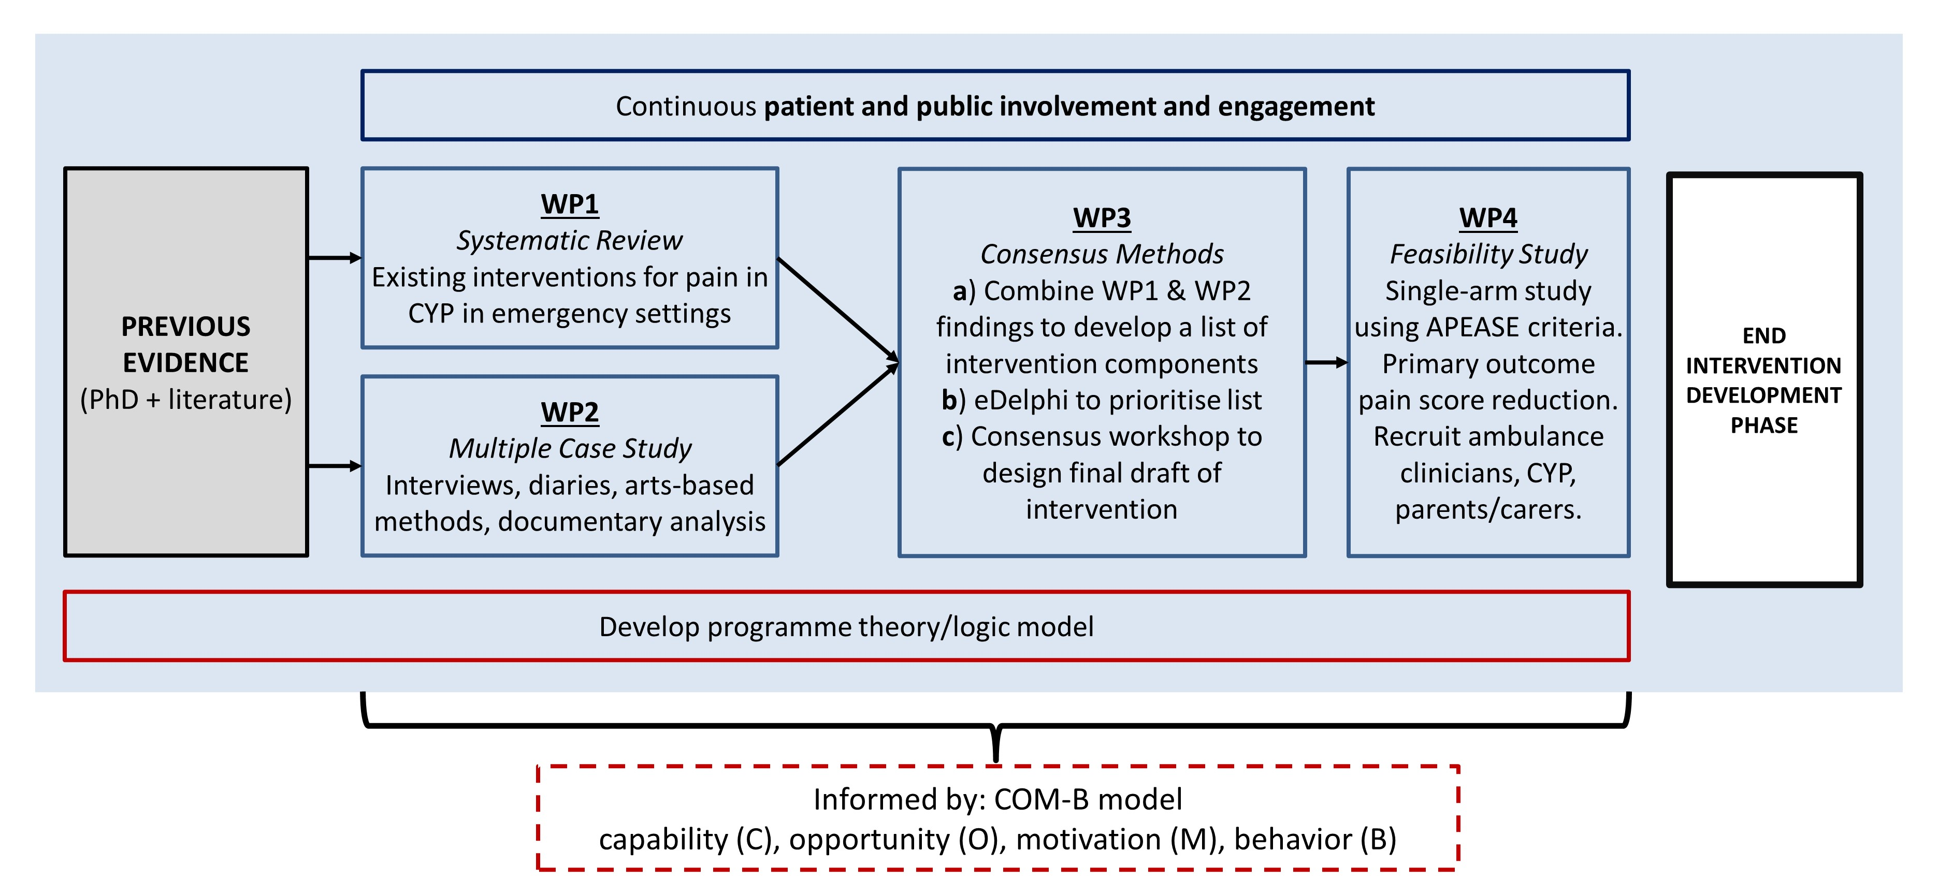
The solution
Date: 11-Mar-2022
Development process
Changes:
Minor tweaks to wording

Slide 16
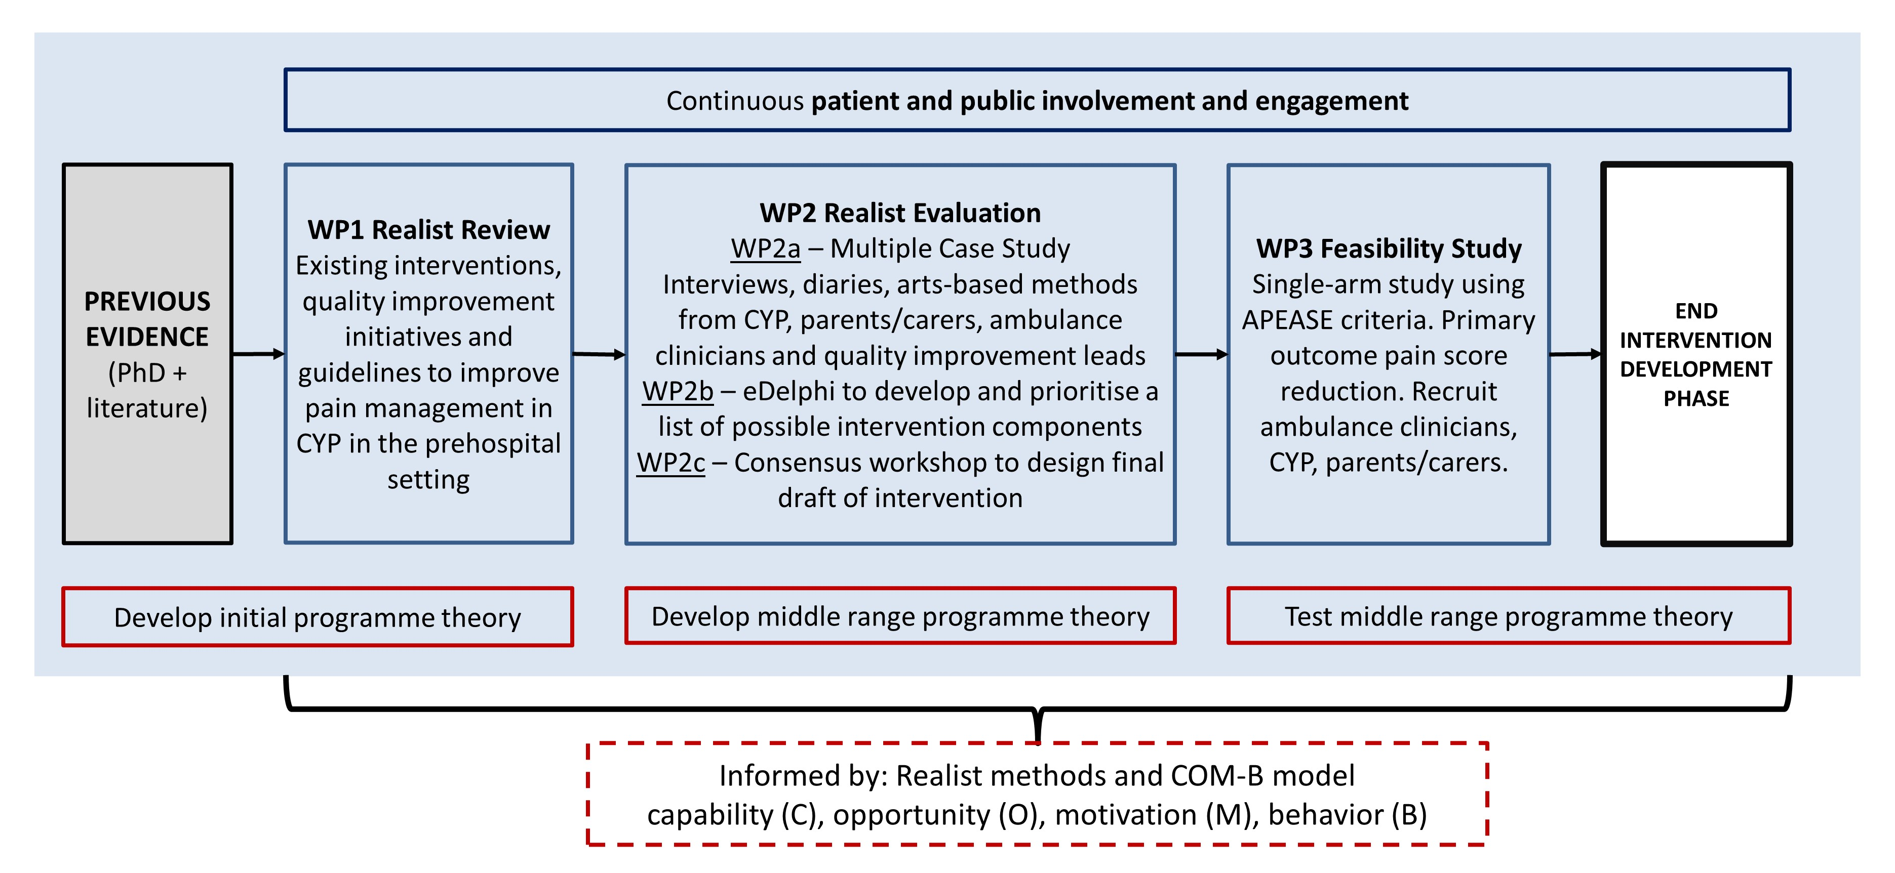
The solution
Date: 31-Mar-2022
Development process
Changes:
Reframed whole study within a Realist approach
Realist review & Realist evaluation
Develop IPTs/Refine IPTs/Test PTs

Slide 17
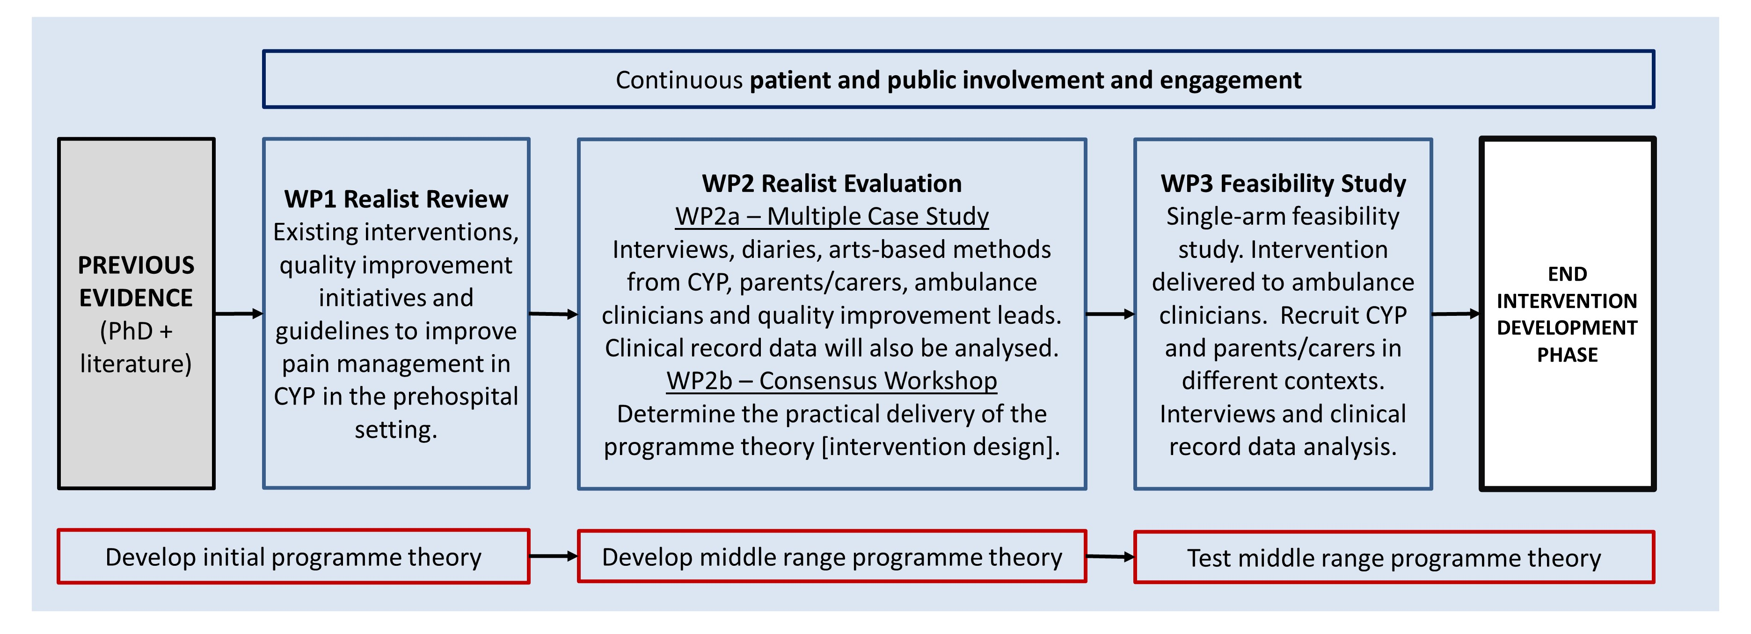
The solution
Date: 13-Apr-2022
Development process
Changes:
Streamlined consensus methods
Removed “informed by realist methods COM-B”

Slide 18
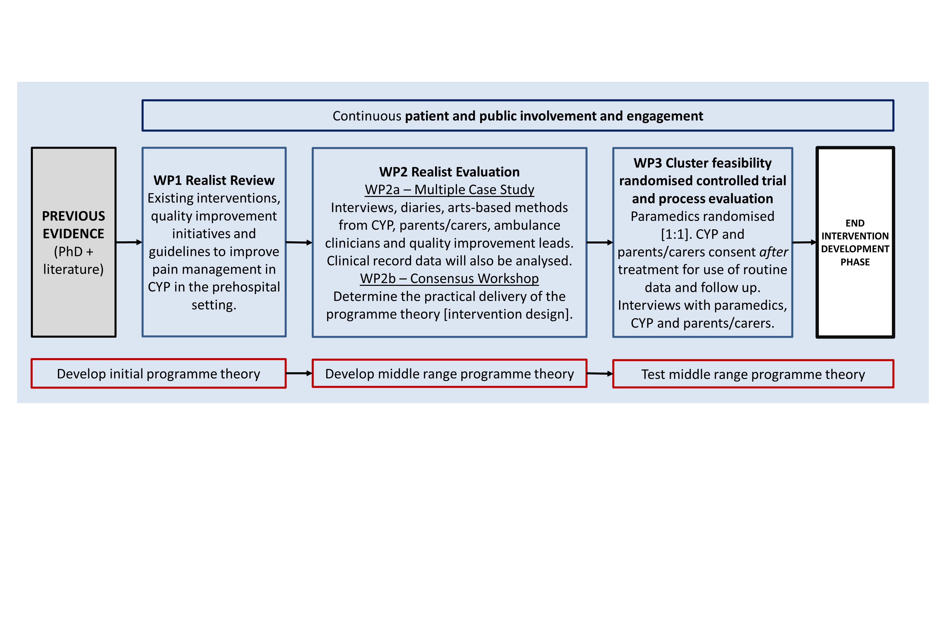
The solution
Date: 29-Apr-2022
Development process
Changes:
Feasibility study refined

Slide 19
The solution
Time
12-18 months to develop a competitive postdoc fellowship application.
Juggling other clinical and academic commitments is challenging!
Personal life?

Slide 20
The solution

Slide 21
The solution
Funding
Postdoc bridging award
Salary [time]
Team – Mentors
PPIE
Action Learning Sets
Mock interview
May 2021-22
https://www.nottingham.ac.uk/clinicalscholar/index.aspx

Slide 22
The solution

Slide 23
The solution
Postdoc bridging award costings
Salary 0.5 days per week EMAS + matched time
Salary 0.5 days per week UoL + scholarly activity
PPIE – Children and young people
PPIE – Healthier Ageing Patient and Public Involvement (HAPPI) group
Conference attendance
Open Access fee for a PhD publication
Total: £13730
Up to £14,000
[funder dependent]

Slide 24
The solution
Team
Consider the following:
Topic experts [population/condition]
Methods experts
Wider context [other relevant specialities]
Networking takes time
Research Design Service
NIHR Infrastructure (ARC/BRC)

Slide 25
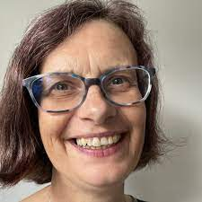
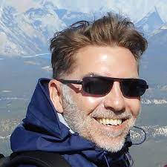
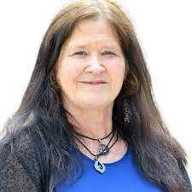
The solution
My Team:
Academic Mentors:
Prof. Niro Siriwardena
Prof. Sarah Redsell
A.Prof Paul Leighton
Practice Mentors:
Prof Julia Williams
A.Prof Bill Lord

Slide 26
The solution
My Team:
Plus many other peers and colleagues…

Slide 27
The solution
PPIE
When you think you’ve done enough… do more
Ensure comprehensive & meaningful engagement
Consider patients & public
Ensure adequate funding (NIHR INVOLVE)

Slide 28
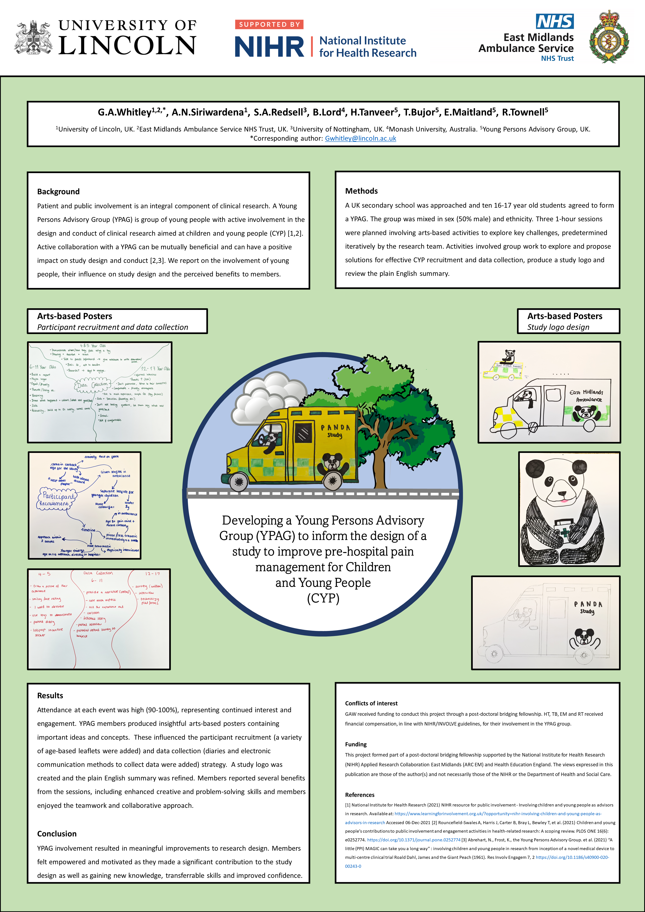
The solution
My PPIE
10 young people (YPAG)
16-17 years of age
3 meetings
6 members of HAPPI group
2 meetings
RDS PPI input (review)
http://dx.doi.org/10.1136/bmjopen-2022-EMS.5

Slide 29
The solution
Costings
Seek support from HEI and RDS for costing support.
Ensure substantial costing for PPIE work!
Consider all shared salary costings [people won’t work for free].

Slide 30
The solution
Key literature

Slide 31
The solution
Key literature
= Importance of including a review

Slide 32
The solution
Key literature
= Importance of including a feasibility study

Slide 33
The solution
Key literature
= Realist methods
= Multiple case study and PPIE
= Consensus methods
= Economic input

Slide 34
The solution
Key literature
https://doi.org/10.1136/bmj.n2061

Slide 35
The solution
Key literature
https://doi.org/10.1186/s40814-019-0425-6

Slide 36
All of these are essential
The solution
Key literature
http://dx.doi.org/10.1136/bmjopen-2019-029954

Slide 37
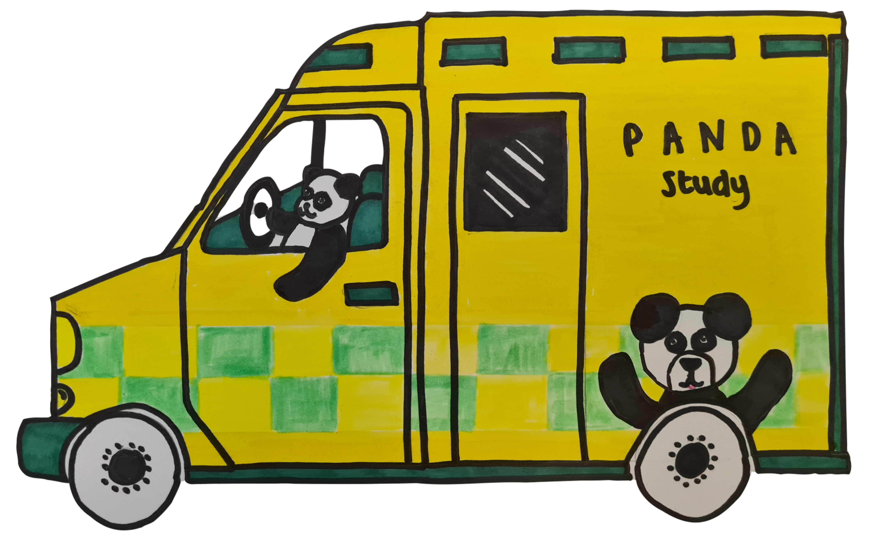
The product
Project title
improving Pain mAnagement for childreN and young people attendeD by Ambulance (PANDA): A realist informed intervention development and feasibility study.

Slide 38
The product

Slide 39
The product
Significant programme of research proposed [45 months]
Training and development in:
Realist methods
Clinical trials management
Leadership
Salary covered + RA 3 years full-time
International research trip Canada
Extensive PPIE involvement

Slide 40
Key takeaway messages
Time: 12 – 18 months to develop a competitive postdoctoral complex intervention development study.
Money: Look for bridging/development awards.
Plan
Read
Network
Complex intervention development papers.
Realist methods.
Wider relevant context.
Utilise all available resources [RDS/ARCs/Peers]
Build a strong team [Mentors, Academics, Clinicians, PPIE]

Slide 41
References
O’Cathain, A., Croot, L., Sworn, K. et al. Taxonomy of approaches to developing interventions to improve health: a systematic methods overview. Pilot Feasibility Stud 5, 41 (2019). https://doi.org/10.1186/s40814-019-0425-6
O'Cathain A, Croot L, Duncan E, et alGuidance on how to develop complex interventions to improve health and healthcareBMJ Open 2019;9:e029954. doi: 10.1136/bmjopen-2019-029954
Skivington K, Matthews L, Simpson S A, Craig P, Baird J, Blazeby J M et al. A new framework for developing and evaluating complex interventions: update of Medical Research Council guidance BMJ 2021; 374 :n2061 doi:10.1136/bmj.n2061
https://www.nihr.ac.uk/explore-nihr/academy-programmes/hee-nihr-integrated-clinical-and-practitioner-academic-programme.htm#four
https://www.nihr.ac.uk/health-and-care-professionals/engagement-and-participation-in-research/involve-patients.htm
Whitley G, Siriwardena A, Redsell S, et al236 Developing a Young Persons Advisory Group (YPAG) to inform the design of a study to improve pre-hospital pain management for Children and Young People (CYP)BMJ Open 2022;12:doi: 10.1136/bmjopen-2022-EMS.5

Slide 42
Keep in Touch Wherever You Are
Online: www.lincoln.ac.uk
Email: enquiries@lincoln.ac.uk
Phone: 01522 886644
University of Lincoln
@UniLincoln
@UniLincoln
University of Lincoln
Notes:
LINCOLN LINK-UP!!!!!!

Slide 43
Thanks for
Listening
Gregory A. Whitley
Gwhitley@lincoln.ac.uk
@gregwhitley7

