Slide 1

CaHRU Improvement Science and Research Methods seminar
Conducting systematic reviews of
qualitative research studies
Patient, carer, and staff perceptions of robotics in motor rehabilitation: a systematic review and qualitative meta-synthesis
Despina Laparidou

Slide 2


Systematic review of qualitative research studies
Systematic Review:
  A comprehensive, unbiased synthesis of many relevant studies in a single document using rigorous and transparent methods;
  A scientific methodology that is reproducible and amenable to rigorous evaluation.
Types of systematic reviews:
  Quantitative systematic reviews & meta-analysis;
  Qualitative systematic reviews;
  Systematic mixed studies reviews;
  Scoping reviews;
  Umbrella reviews.

Slide 3
Formulate Review Question
Key stages in
conducting a
systematic review
Develop Protocol
Search, Identify & Select Evidence
Data extraction
Risk of Bias Assessment
Data Synthesis & Interpretation
Conclusions & Recommendations
Write Review Report

Slide 4

Formulate review question
PICo
Population
Phenomena of Interest
Context
Example
What are patients’, their carers’, and healthcare professionals’ perceptions of and/or experiences with robotic interventions in motor rehabilitation?
Population
Phenomena of Interest
Context

Slide 5
Systematic review standards
Reporting standards exist to guide review reports:
  PRISMA (Preferred Reporting Items for Systematic Reviews and Meta-Analyses);
  PRISMA-ScR (PRISMA Extension for Scoping Reviews);
  ENTREQ (Enhancing Transparency in Reporting the Synthesis of Qualitative Research);
  Cochrane Handbook and MECIR (Methodological Expectations of Cochrane Intervention Reviews).
We used the ENTREQ guidelines for enhancing transparency in reporting the synthesis of qualitative research.

Slide 6
Develop protocol
The review protocol is the first major milestone of any systematic review
  Provides a rigid, well-specified plan for how each stage of the review will be conducted – a roadmap;
  Helps to avoid or minimise bias at each stage of the review – but only if followed rigidly;
  Should be sent for external peer review, e.g. advisory group comprising researchers, practitioners, users, etc.;
  Should be published, e.g. project webpage, research register, or peer-reviewed journal.
Our review protocol was registered with the PROSPERO International prospective register of systematic reviews (CRD42019137852) and is available from: https://www.crd.york.ac.uk/prospero/display_record.php?ID=CRD42019137852

Slide 7
Construct your search strategy
Truncation & Wildcards
Search ID | Search terms
S1. | robotic* OR robot* OR robotic therap* OR robot-assisted OR robot assisted OR exoskeleton* OR assistive robotic* OR walking robotic device* OR personal care robot* OR medical robot* OR assistive OR assistive automation OR wearable robot* OR orthotic* OR orthosis OR exoskeletal* OR exo OR end-effector OR haptic* OR robot regulation*
S2. | rehab* OR intervention* OR treatment* OR therap* OR program* OR strateg* OR training OR physiotherap* OR physio-therap* OR “physio therap*” OR “physical therap*”
S3. | Qualitative research OR qualitative OR interview* OR focus group* OR ethno* OR phenomenolog* OR hermeneutic* OR grounded theory OR narrative analysis OR thematic analysis OR lived experience* OR life experience*
S4. | (MH "Qualitative Research") OR "Qualitative research"
S5. | S3 OR S4
S6. | S1 AND S2 AND S5
MeSH (Medical Subject Headings)
Boolean operators (AND/OR/NOT)

Slide 9
Data extractions
Recording of information presented in primary studies
Strike the right balance between reporting/recording too much or too little information
Important data to extract:
  Participants: demographic/disease characteristics, inclusion/exclusion criteria, sample size, etc.;
  Study characteristics: aims, objectives, research questions, study design, setting, sampling method, data collection methods (e.g. interview, focus groups), etc.;
  Data analysis: e.g. thematic analysis, interpretative phenomenological analysis, etc.;
  Results: use NVivo software to facilitate analysis.

Slide 10
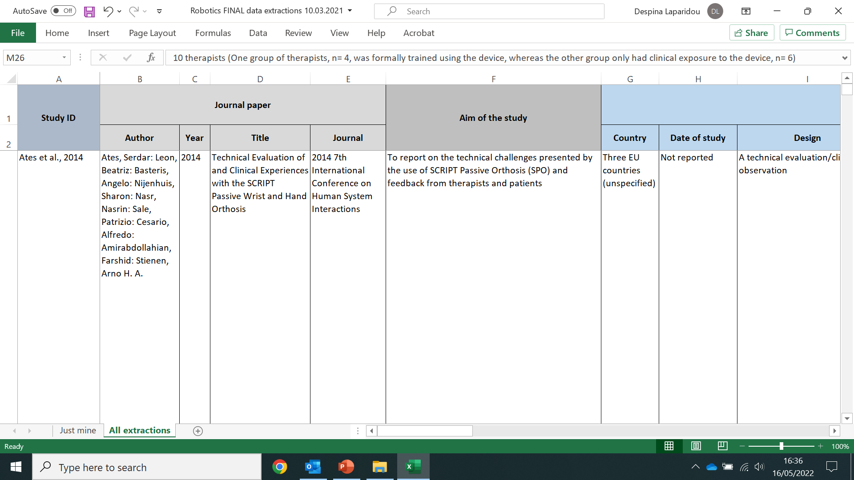
Data extraction form

Slide 11
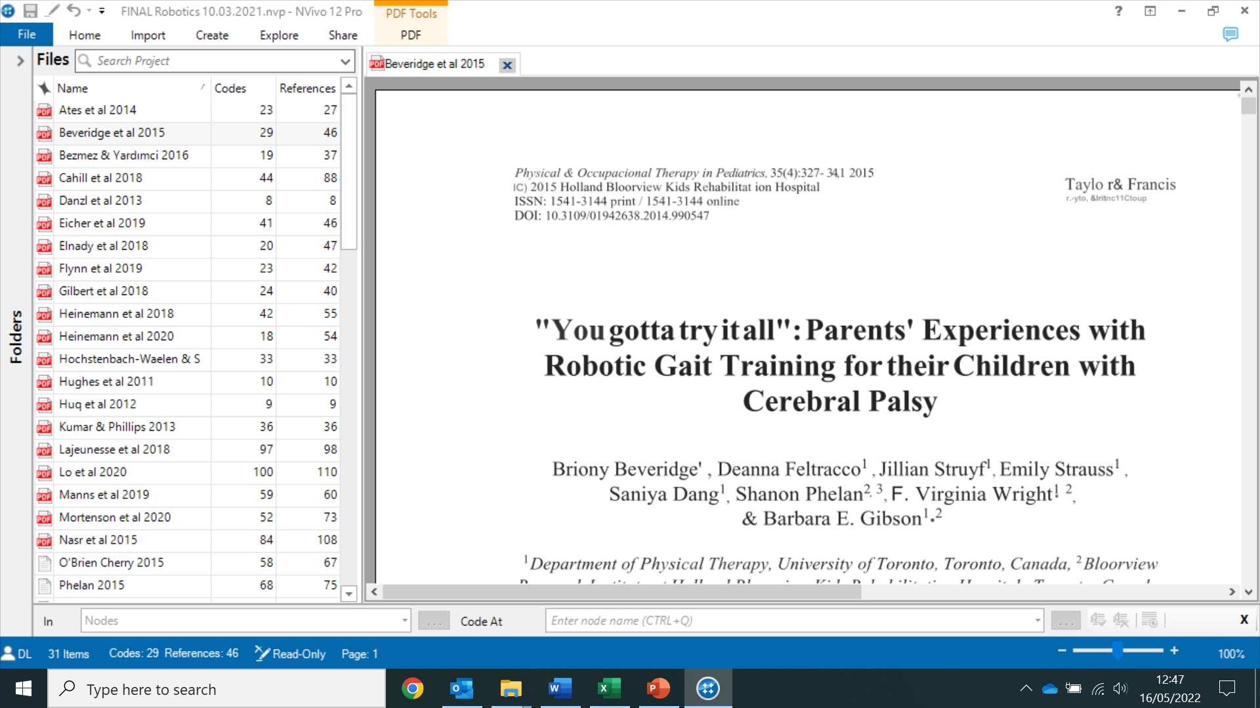
Data extraction - NVivo

Slide 12
Quality assessment
Critical appraisal focuses on:
congruity between philosophical position adopted in the study, study methodology, study methods, representation of the data and the interpretation of the results;
Critical appraisal tools enable you to systematically assess the trustworthiness, relevance and results of published papers;
Two reviewers to independently assess quality.

Slide 13
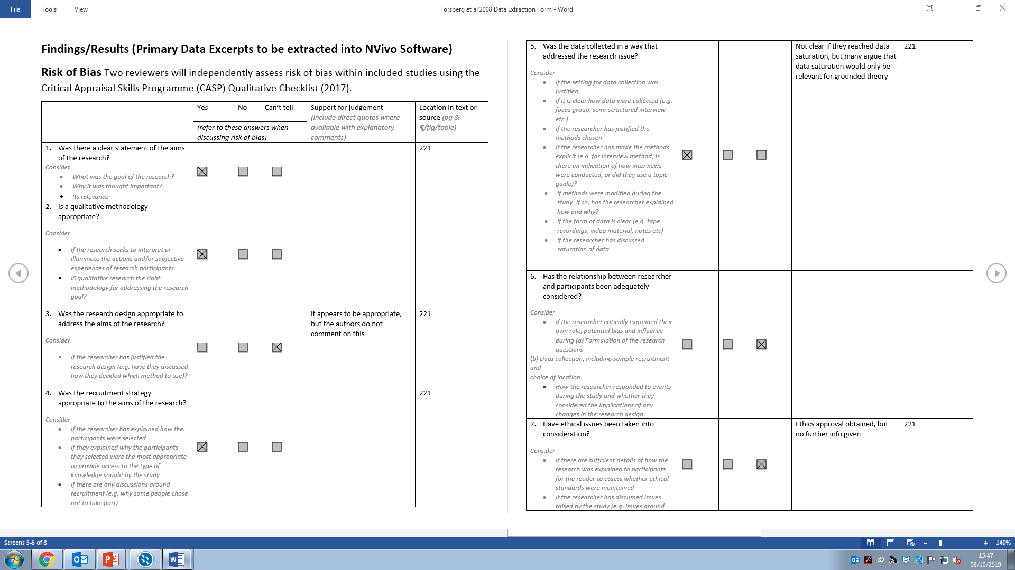
Critical Appraisal Skills Programme (CASP) Qualitative Checklist (2017

Slide 14
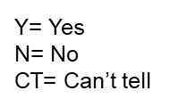
Quality assessment

Slide 15

Quality assessment

Slide 16
Reflexive statement
Reflexivity enables authors to recognise the assumptions and preconceptions they bring into the research and may influence the research process, while allowing the reader to understand the dynamics between the researcher and the researched.
Things to consider:
  Researchers’ professional background & knowledge/experience of working in the review area
  External factors, e.g., funder of the study/review contributing in the development of the review’s main objectives
  Any other potential influencing factors that may have incidentally affected the research, such as personal experiences or prior assumptions, judgments, practices, and belief systems, etc.

Slide 17

Data synthesis & interpretation
Approaches to Qualitative Synthesis:
  Thematic synthesis - our approach;
  Narrative synthesis;
  Realist synthesis;
  Content analysis;
  Meta-ethnography;
  Meta-aggregation.

Slide 18
Data synthesis & interpretation
Thematic synthesis takes the form of three stages:
  free line-by-line coding of the findings of primary studies, according to meaning & content
  looking for similarities and differences between codes & organising them into related areas to construct 'descriptive' themes
  development of 'analytical' themes’, generating additional concepts, understandings or hypotheses

Slide 19
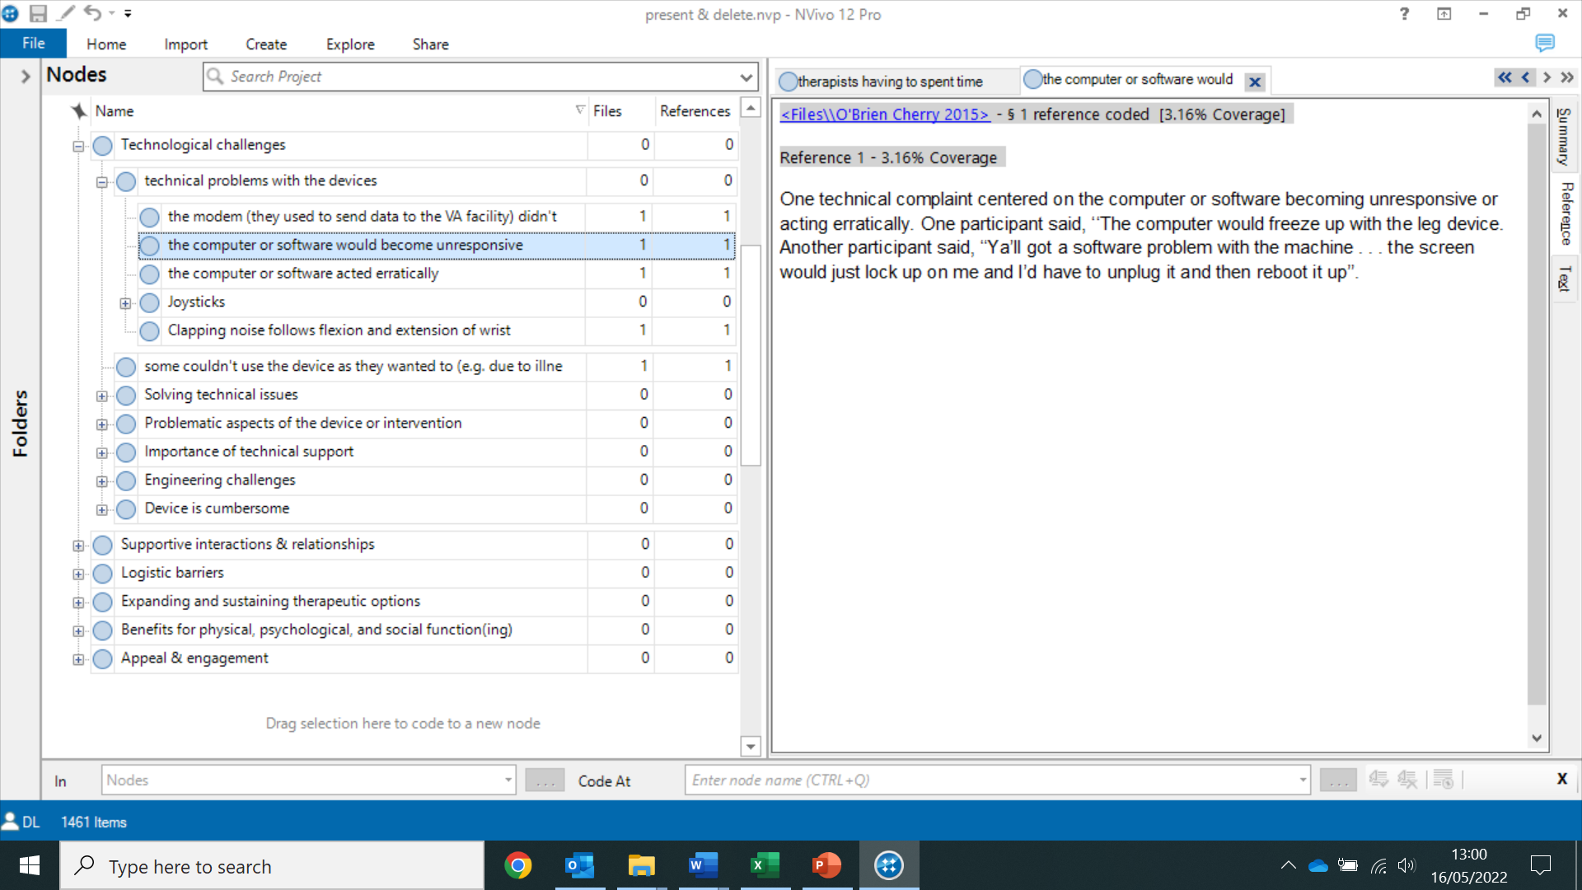
Data synthesis & interpretation

Slide 20
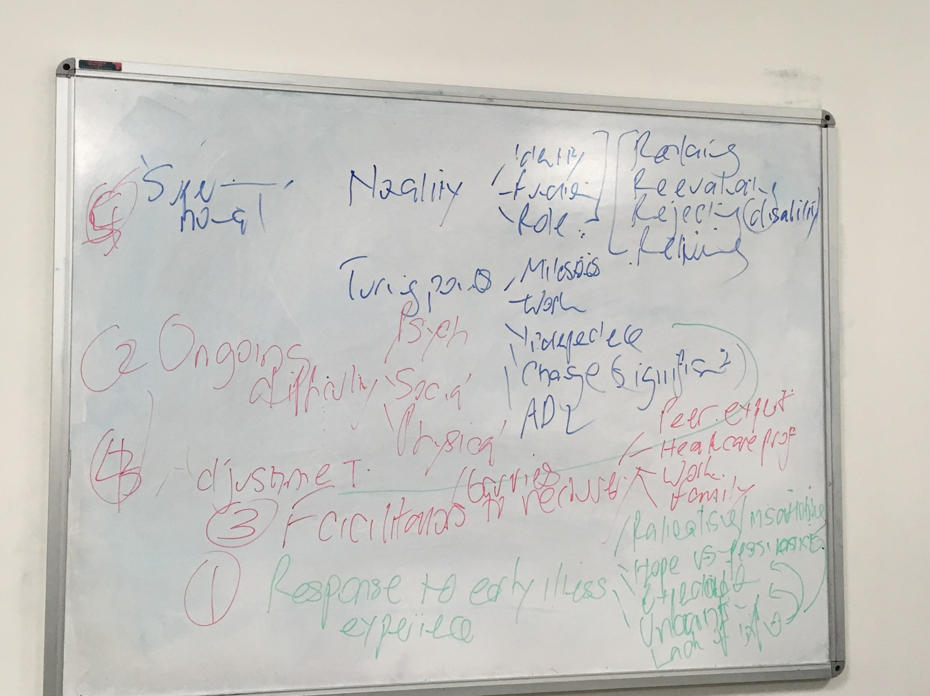
Data synthesis & interpretation

Slide 21
Present results- Evidence table

Slide 22
Thomas & Harden (2008) Thematic synthesis

Slide 23
Present results- Main themes

Slide 24
Present results- Main themes

Slide 25
Our systematic review- Conclusions
Despite experiencing technological and logistic challenges, participants found robotic devices acceptable, useful and beneficial, as well as fun and interesting.
Having supportive relationships with significant others and positive therapeutic relationships with healthcare staff were considered the foundation for successful rehabilitation and recovery.
Exploring this literature has enabled us to:
  Explore the acceptability of robotic devices in motor rehabilitation by different end-users;
  Identify possible facilitators and barriers to the use of such devices in therapy;
  Make recommendations to manufacturers, apps/games designers and developers, as well as health and social care services.

Slide 26
References
Aromataris, E., & Pearson, A. (2014). The Systematic Review: An Overview. The American Journal of Nursing, 114 (3), 47-55.
Laparidou, D., Curtis, F., Akanuwe, J., Goher, K., Siriwardena, A.N., & Kucukyilmaz, A. (2021). Patient, carer, and staff perceptions of robotics in motor rehabilitation: a systematic review and qualitative meta‑synthesis. Journal of NeuroEngineering and Rehabilitation, 18:181. https://doi.org/10.1186/s12984-021-00976-3
The Joanna Briggs Institute (JBI).
Thomas, J., & Harden, A. (2008). Methods for the thematic synthesis of qualitative research in systematic reviews. BMC Medical Research Methodology, 8, 45. Doi: 10.1186/1471-2288-8-45
Tong, A., Flemming, K., McInnes, E., Oliver, S.A., & Craig, J. (2012). Enhancing transparency in reporting the synthesis of qualitative research: ENTREQ. BMC Medical Research Methodology, 12, 181.

Slide 27

Thank you for listening!
Any questions?
Now, or later
Despina Laparidou
Community and Health Research Unit (CaHRU)
Email: dlaparidou@lincoln.ac.uk

